Slide 1


Growth Rate Comparison Using Visualization
An analytical breakdown of O(n), O(n log n), and O(n²) time complexities, defining input assumptions, dominance parameters, and algorithmic selection.
Course Name Design and Analysis of Algorithms
Course Code CSA0624
Presenter Name Karthikeyan. K
Registration Number 192425072

Slide 2


Introduction & Asymptotic Notation
Time Complexity & Big-O
Big-O notation describes the upper bound of an algorithm's running time as the input size (n) approaches infinity, allowing us to evaluate performance regardless of hardware speed.
INPUT ASSUMPTIONS
The Three Core Functions
'n' represents the total size of the input data structure (e.g., array length).
O(n) - Linear Time: Processing time grows directly in proportion to the input size. O(n log n) - Linearithmic Time: Commonly found in efficient divide-and-conquer algorithms. O(n²) - Quadratic Time: Time grows exponentially relative to the input, typical in nested iterative loops.
A single algorithmic operation takes 1 unit of constant time to execute.
We evaluate worst-case scenarios as n → ∞.

Slide 3
Tabulating Growth Rates
By inputting exact values for n into our three complexity classes, we can observe the massive divergence in computational cost as the dataset scales from small to enterprise levels.
Input Size (n) | O(n) Linear | O(n log n) Linearithmic | O(n²) Quadratic
n = 10 | 10 operations | ≈ 33 operations | 100 operations
n = 100 | 100 operations | ≈ 664 operations | 10,000 operations
n = 1,000 | 1,000 operations | ≈ 9,965 operations | 1,000,000 operations
n = 10,000 | 10,000 operations | ≈ 132,877 operations | 100,000,000 operations

Slide 4


Algorithm Selection Insights
Optimal Selections
Limitations & Caveats
O(n) Scaling Power: Extremely efficient for simple traversals, searching, or mapping. Highly scalable, but very few complex tasks (like sorting) can be solved in pure linear time.
O(n²) System Overload: While algorithms like Bubble Sort or nested iterations are easy to code, they scale terribly. An input of just 100,000 items requires 10 billion operations, causing system freezes.
O(n log n) The Sweet Spot: The definitive theoretical limit for comparison-based sorting (Merge Sort, Quick Sort). Perfectly balances computational load for massive databases.
Hidden Constants: For extremely small values of n (e.g., n < 10), an O(n²) algorithm might actually run faster than an O(n log n) algorithm due to lower overhead/constant factors.

Slide 5


Code & Structural Signatures
Efficient_Algorithms.cpp
Inefficient_Algorithms.cpp
// 1. O(n) Linear Time - Simple Array Traversal
void
linearSearch(int arr[], int n, int target) { for (int i = 0;
i < n; i++) { if (arr[i] == target) return; } }
// 2. O(n log n) Linearithmic Time - Merge Sort
void mergeSort(int arr[], int left, int right) { if (left < right) { int mid = left + (right - left) / 2;
// Divide phase (log n depth)
mergeSort(arr, left, mid); mergeSort(arr, mid + 1, right);
// Conquer/Merge phase (n operations per level)
merge(arr, left, mid, right); } }
void bubbleSort(int arr[], int n) {
for (int i = 0; i < n - 1; i++)
{
for (int j = 0; j < n - i - 1; j++) {
if (arr[j] > arr[j + 1]) {
// Swap elements
int temp = arr[j]; arr[j] = arr[j + 1];
arr[j + 1] = temp; }
}
}

Slide 6
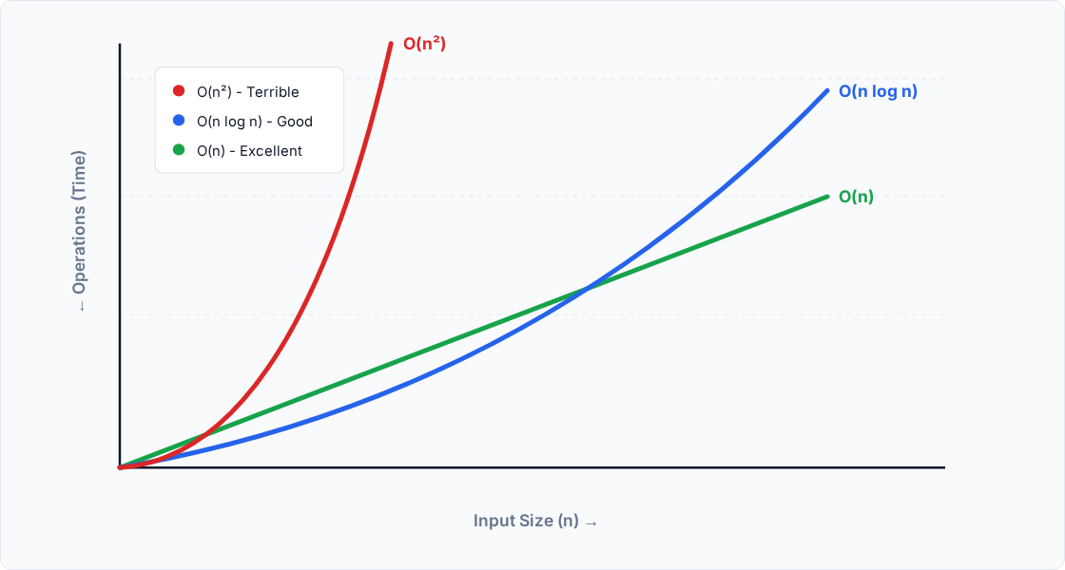
Graphical Visualization of Growth Rates

Slide 7



Conclusion & Dominance Analysis
The Concept of Dominance
When analyzing growth, O(n²) completely dominates O(n log n) and O(n). This means that as n scales to infinity, the quadratic term grows so violently that lower-order functions become statistically negligible in performance comparisons.
Justification of Algorithm Failure
Our tabular and graphical data prove that O(n²) algorithms hit a "computation wall." A quadratic algorithm handling 1,000,000 database entries requires 1 trillion operations, whereas O(n log n) processes the same data in roughly 20 million operations—a life-saving difference in software engineering.
Insights for Algorithm Selection
For small datasets, developer implementation speed often overrides big-O efficiency (e.g., using a quick Bubble Sort). However, for any production-level system anticipating scalable data, standardizing on O(n log n) algorithms (Merge/Heap sort) is an absolute architectural requirement.

Slide 8
Thank You
Open Discussion & Questions

